Slide 1
HEART DISEASE
Diagnostic Analysis

Slide 2
ABOUT
Heart disease analysis is a multidisciplinary approach that involves collaboration between cardiologists, primary care physicians, radiologists, and other healthcare professionals.
The goal is to provide comprehensive care, early detection, and effective management of heart-related conditions to improve patient outcomes.

Slide 3
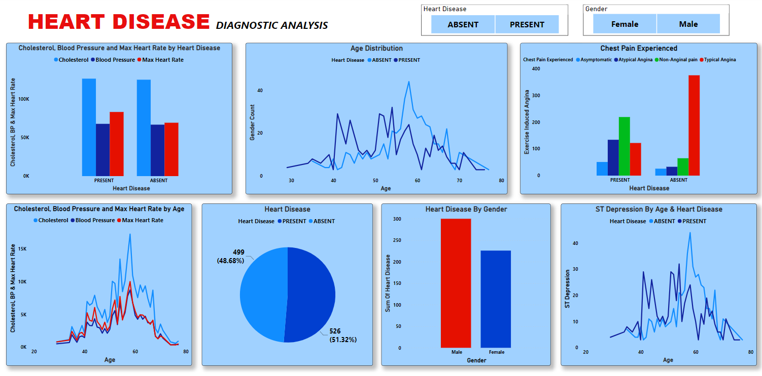

Slide 4
KEY INSIGHTS
Data Integrity: No missing values were found in the dataset, ensuring robust and reliable results.
Prevalence of Heart Disease: Contrary to expectations, the percentage of individuals without heart disease (51.32%) slightly surpasses those with heart disease (48.66%) in the overall population.
Gender Disparities: Males exhibit a higher susceptibility to heart disease, emphasizing the need for targeted interventions in this demographic.
Asymptomatic Chest Pain: Individuals with asymptomatic chest pain show a higher likelihood of heart disease, underscoring the importance of proactive monitoring.
Cholesterol and Blood Pressure Trends: Higher cholesterol and blood pressure levels are associated with an increased risk of heart disease, with subtle variations between genders.
Gender-specific Insights: More males experience asymptomatic chest pain, while ST Depression is more prevalent among males compared to females.

